Slide 1
Goo Intruders
Nakiya White
Jaleia Oatman
Science Question: How can the amount of water affect the speed of the Goo coming down the chute?
Hypothesis: If you add 2.5ml of water, then the Goo will go faster down the chute.

Slide 2
Materials
Structure
Goo
50cm by 24cm cardboard box
77cm by 28cm plastic wrap
(2 )12cm by 5cm duct tape
(6) 5cm b 5cm duct tape
Oatmeal box that is 24cm in height
2 huge rocks
(3) 10cm by 5cm duct tape
(2) 4cm by 5cm duct tape
(1) 20cm by 5cm duct tape
½ cup warm water
2tsp Borax
1 qt. plastic zip lock bags
Food coloring(optional)
20-ounce cup
1 cup white cup
8-ounce cup
2 stirring strings

Slide 3
Procedures for Structures
Gathered up materials needed.
Cut a 50cm by 24cm piece of cardboard.
Cut a 77cm by 28cm piece of plastic wrap.
Cut a 2 pieces of duct tape, with a measurement 12cm by 5cm.
Then cut 6 pieces of duct tape, with a measurement of 5cm by 5cm.
Cover cardboard with plastic wrap.
Turn over the cardboard and tape the 12cm pieces along the top and bottom.
Then take 3 of the 5cm pieces along both sides of the cardboard.
Take the cardboard and put it on the oatmeal box at a 40 degree angle.
Take the 2 10cm pieces and tape it to the back, where the back of cardboard sticks to inside oatmeal box.
Take the other 10cm piece and tape it underneath where the cardboard sticks to the oatmeal box.
Take the 2 4cm pieces and tape it on both side of the 10cm piece.
Drop the 2 rocks inside the oatmeal box.
Finally take the 20cm piece and tape it to the back of the cardboard box, where the cardboard box tip is taped to the other side of the oatmeal box.

Slide 4
Procedures for Goo
Mix one
In a large cup, add ¾ cup warm water and 1 cup glue(for color add 6 drops of food coloring). Stir until well mixed.
Mix Two
In the small cup, measure ½ cup warm water. Add 2 tsp. of Borax powder. Stir until the Borax is dissolved.
Combine mix 1 with mix 2. stir until a glob forms and most of the water and most of the water is mixed in.
Knead and work the for 2-3 minutes. Most, if not all, of the water will be incorporated.
Place glacier goo in Ziploc bag. ( will last for a few months)

Slide 5
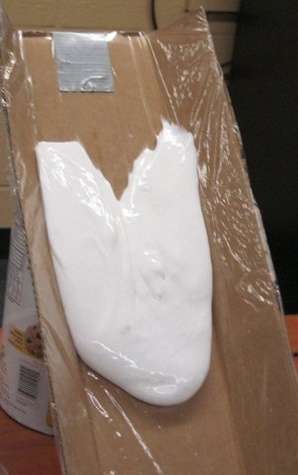
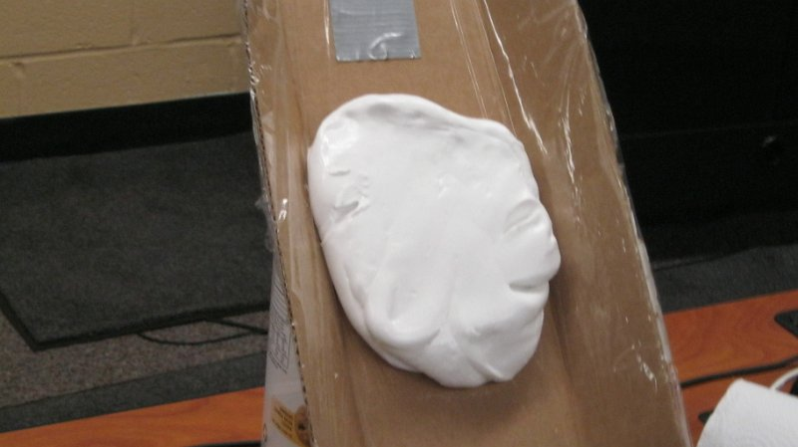
Results
Control Group | Experimental Group
16 minutes 29 seconds | 14 minutes 17 seconds
Experimental
Control

Slide 6
Conclusion
Conclusion: Our hypothesis was that if we add water to the chute then it will go faster. Our hypothesis was proven to be correct.
Suggestions: We think that you should do a shorter chute.

